Slide 1
Customer retention
Submitted by- KAUShik veer

Slide 2
Contents
Introduction
Problem Statement
Analysis
Customer Retention
Conclusion

Slide 3
Introduction
E-retail factors for customer activation and retention: A case study from Indian e-commerce customers
Customer satisfaction has emerged as one of the most important factors that guarantee the success of online store; it has been posited as a key stimulant of purchase, repurchase intentions and customer loyalty. A comprehensive review of the literature, theories and models have been carried out to propose the models for customer activation and customer retention.

Slide 4
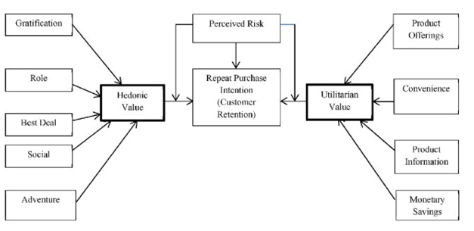
Problem statement
Five major factors that contributed to the success of an e-commerce store have been identified as: service quality, system quality, information quality, trust and net benefit. The research furthermore investigated the factors that influence the online customers repeat purchase intention. The combination of both utilitarian value and hedonistic values are needed to affect the repeat purchase intention (loyalty) positively. The data is collected from the Indian online shoppers. Results indicate the e-retail success factors, which are very much critical for customer satisfaction.

Slide 5
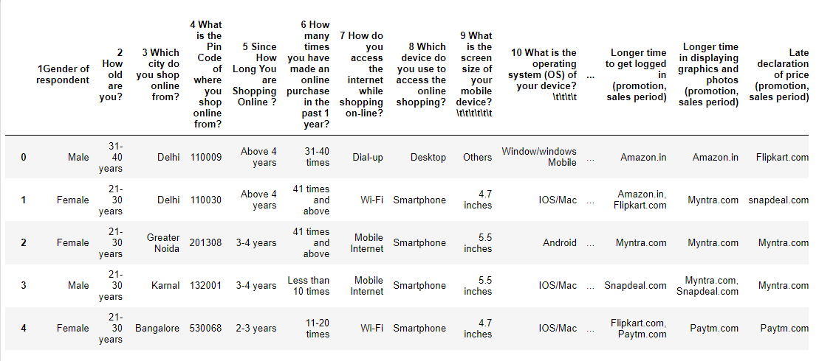
Above is the snapshot of the data that is provided.
The combination of both utilitarian value and hedonistic values are needed to affect the repeat purchase intention (loyalty) positively.

Slide 6
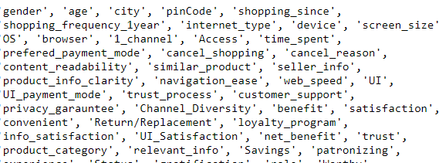
Analysis
The data contains 269 number of rows and 71 columns
The whole data is in object type data but we were already provided with the encoded dataset so we used that data.
we have assigned short names for the data columns to get better understanding of the data.
we will be dropping the screen size and pincode
by logical reason we already have the city name and pincode does not help in a special way.
screen size does not matter while ordering online as long as the information is readable.

Slide 7
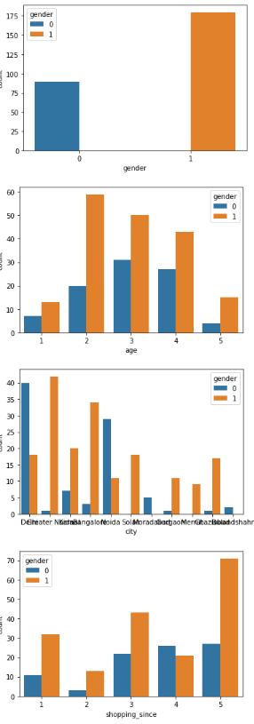
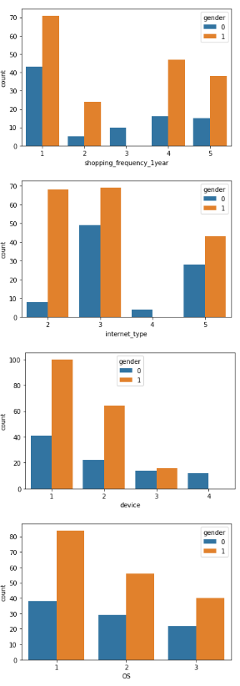
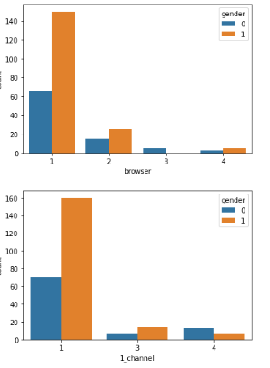

Slide 8
Observations from the above graphs
we can see the majority of online shoppers on the female side
most number online female shoppers comes from under 21-30 age group and for male the majority shoppers comes from 31-40 age group.
Delhi is having the highest number of male shoppers as well as the over all majority of shoppers compared to the city. greater noida have the highest number of female online shoppers.
majority of the people have been shopping since last 4 years.
the frequency of people shopping in a year is less than 10 times.
mostly people will use smartphones to purchase products online.

Slide 9
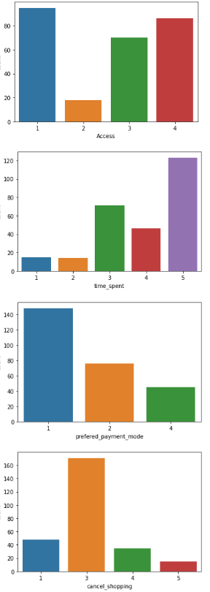
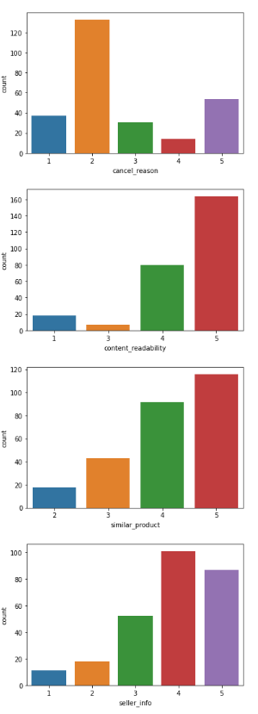
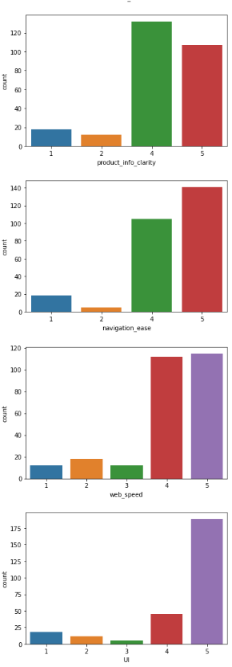
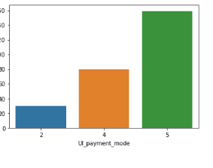

Slide 10
Observations from the above
Generally people spent more than 15 mins on online shopping platforms and browse through the variety of products.
Credit cards and debit cards are mostly used for making payments online as they also offer various discounts and EMI services.
Sometimes people also cancel some orders after placing the orders. Most of the times the reason to cancel is finding better alternative of the products on the platforms or the same platform.
People strongly agree that similar products should be found for product comparison.
Seller information should be mentioned says most of the people. Product details should be mentioned in detail.
People wants ease of navigation for finding products, good connectivity, user interface should be easy to understand and convenient payment methods.
All these things helps the consumer to do online shopping very easily.

Slide 11
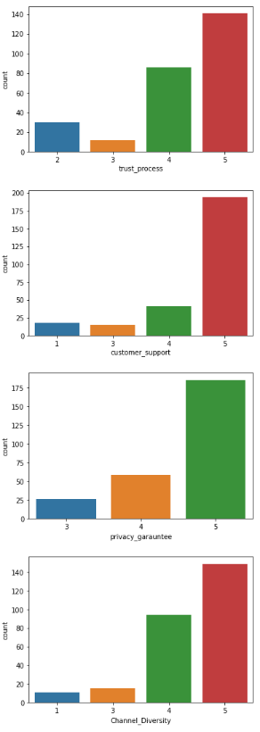
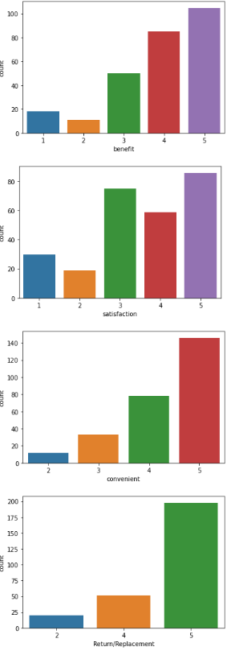
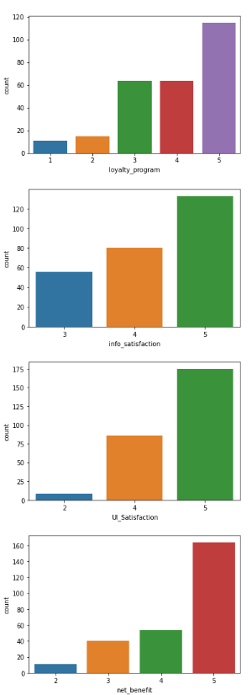
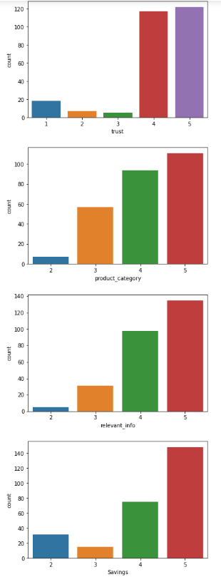
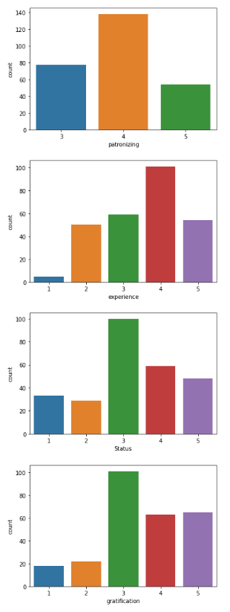

Slide 12
Observations from the above
People strongly trust the idea of this online shopping and if they face any problem the platform will be ready to assist them.
People believe that they will keep their private data safe and secure and they will be responsiveness on multiple places like email, chats, etc.
People strongly agree that Online shopping gives monetary benefit and discounts, Enjoyment is derived from shopping online, Shopping online is convenient and flexible.
People wants to see the return and replacement policy to be mentioned clearly and in detail before taking their decision, information of the products should be easily understandable is what improves customer satisfaction and giving them access to loyalty programs will help in customer retention.
Users derive satisfaction while shopping on a good quality website or application.
People find a variety of products on online websites which help them to take better buying decisions and help in customer satisfaction.
People look for products which are value for money on the online platforms and help them in monetary savings.

Slide 13
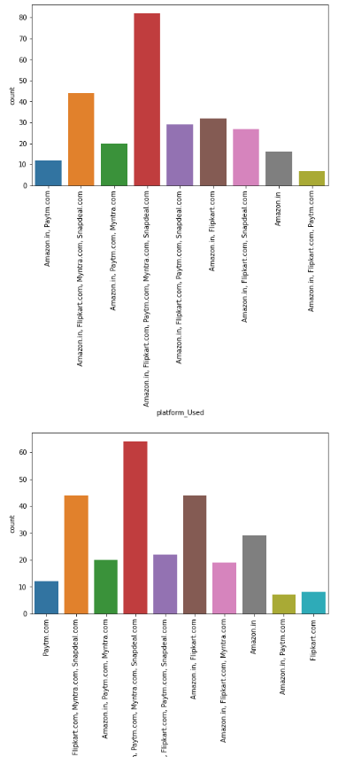
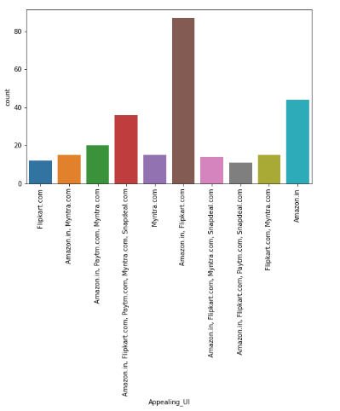
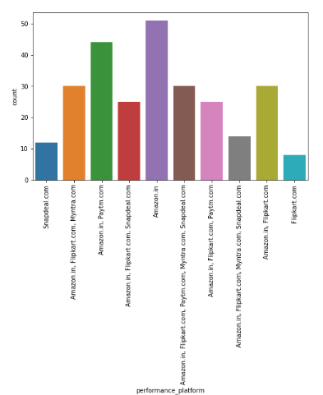
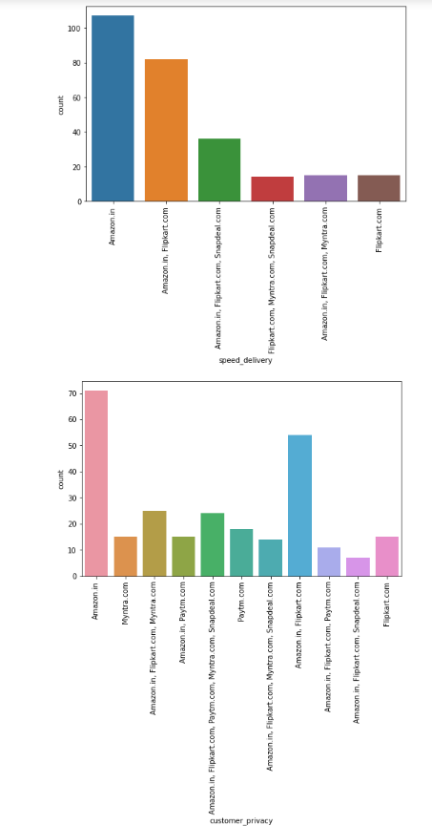
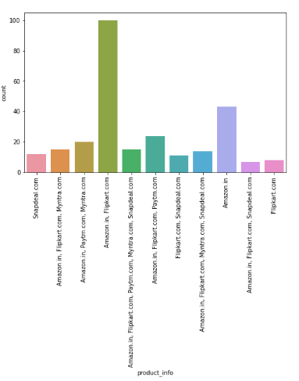
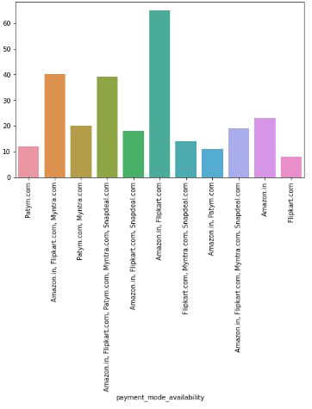
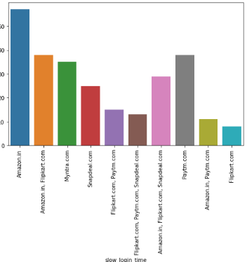

Slide 14
Observation from above
In terms of 'platform_Used','convinient_accessibility','Appealing_UI','product_diversity' people strongly prefer amazon and flipkart for online purchases as the user interface is very easy to understand and there are variety of products provided and product diversity is good and it helps in customer satisfaction and these platforms are most used and trusted by the people.
People trust amazon in terms of data privacy and financial security and over all trust worthiness followed by flipkart and myntra.
flipkart tops in fastest login time
myntra and snapdeal are slow in loading the website compared to other platforms.
PayTm is very slow in delivery of the products and amazon is the fastest
People are most likely to recommend amazon and flipkart for making online purchases to other people.

Slide 15
Customer retention
We checked the hedonic values as well as the utilitarian values and what we found is
Social status of among the peers, finding best deals frequently and platforms role helps in customer retention positively.
Convenience is using the website, detailed information of the product strongly influence customer buying decision positively.
From above we can see that when user has used all the platform he is never recommending Snapdeal.¶
Amazon & flipkart are most recommended.
Fast speed of delivery and fast loading speed, login time is also one of the factors that leads to customer retention.
Better Customers support helps people in retention of customers.
loyalty programs, discounts and monetary benefits helps customers to find value for money products and are most likely to recommend the platform to other people.

Slide 16
People wants ease of navigation for finding products, good connectivity, user interface should be easy to understand and convenient payment methods.
Product details and images of the product should be clearly mentioned as well as return policy is what a customer checks before ordering any product online which help the customer to trust the platform.
Keeping the private data and giving financial data security helps the customer to build a trust a factor towards the particular platform.
Assisting the customers on time and providing wide range of products with variety will keep the customer on the platform for longer period.
Good payment gateway helps the customer in making payments easily also providing EMI services will help them to buy more products.
Appealing User interface helps the customers to browse the platform easily and find products faster which helps in Customer Satisfaction.
People wants ease of navigation for finding products, good connectivity, user interface should be easy to understand and convenient payment methods.
Product details and images of the product should be clearly mentioned as well as return policy is what a customer checks before ordering any product online which help the customer to trust the platform.

Slide 17
Conclusion
Amazon and Flipkart are most used and recommended platforms.
These platforms have higher rating in every terms.
Amazon and flipkart are the ones which has higher chances of customer activation and recommendation.¶
Rest all platforms should be improved or their existing users are going their platforms.
People wants to see the return and replacement policy to be mentioned clearly and in detail before taking their decision, information of the products should be easily understandable is what improves customer satisfaction and giving them access to loyalty programs will help in customer retention. Amazon and flipkart are already better in these terms and other platforms are getting better day by day.

Slide 18
we can see the majority of online shoppers on the female side and most number online female shoppers comes from under 21-30 age group and for male the majority shoppers comes from 31-40 age group.
Most of the people are shopping since more than 4 years and platforms are using aggresive discounts and advertising to attract customers.
People trust Amazon and flipkart for keeping their data safe but other platforms are also building trust factor with their customers and they are getting better day by day.
Ease of navigation and finding value for money product is what a customers tries to find on a platform and Amazon is very good in these terms.
Amazon and flipkart are the oldest platforms hence people first preferece is amazon and flipkart and mostly recommended.
People tend to buy more products if there are more discounts and better EMI services.

